Slide 1
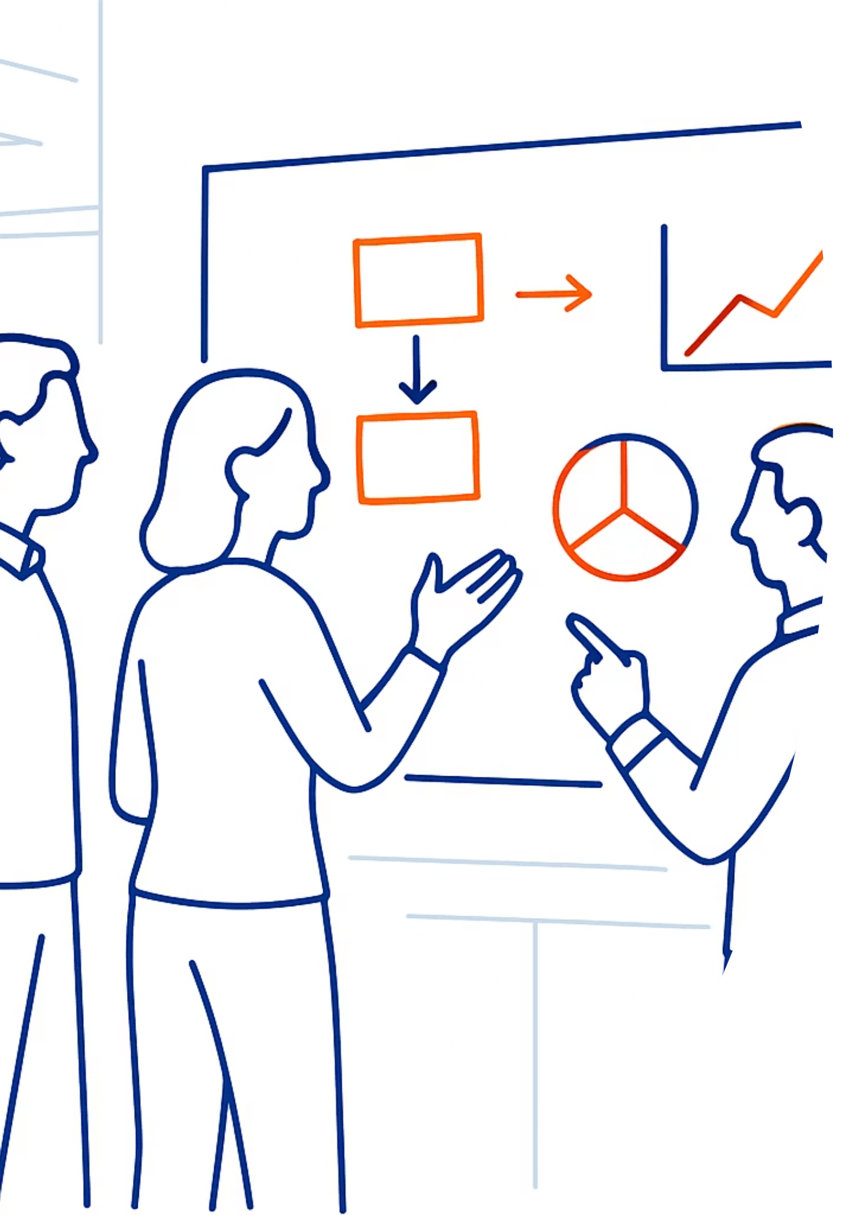

FlowOps360™: Sales & Buyer Map QuickStart Guide
Welcome to your comprehensive guide for aligning sales execution with buyer psychology. This QuickStart framework gives you the essential tools to map, measure, and optimize how deals move through your pipeline.
Tingom Group | FlowOps360™

Slide 2

Why Map Your Journey? The Foundation for Predictable Revenue
The Map's Purpose
This kit combines your internal Sales Process (what your team does) with the Customer Journey (what the buyer thinks and needs). Aligning these two maps stops confusion and prevents deals from getting stuck.
Five Critical Questions Answered
Question
Answer
Why This Matters
WHO should use this?
Business Owners, Sales Leaders, and Marketing Managers
Ensures everyone shares one version of the truth across your organization
WHAT is it?
A single document mapping buyer thoughts to seller stages
Eliminates guesswork in forecasting and pipeline reviews
WHERE is it enforced?
In your CRM (e.g., HubSpot, Salesforce)
Ensures every sales rep follows the system automatically
WHEN do you use it?
Before training a new hire or making a sales forecast
Provides objective criteria for advancing a deal
WHY is it critical?
Predictability. Consistent process equals predictable results
Stops fake forecasts and reduces sales cycle time
The Golden Rule: Focus on the Buyer
Your sales stages must reflect the Buyer's Confirmed Progress, not just your team's activity. If the buyer hasn't done something, the deal can't move forward. This is the fundamental principle that separates winning organizations from those that struggle with pipeline accuracy.
Tingom Group | FlowOps360™
© 2025 Tingom Group, LLC

Slide 3
Sample Business: Fractional CFO Services
This example demonstrates how a professional services firm selling ongoing financial strategy and guidance to small-to-midsize businesses applies the FlowOps360™ framework. Use this as your template for understanding how sales stages and exit criteria work in practice.
Sales Process Map: Stages & Exit Criteria
Stage Name
Stage Owner
Exit Criteria (Buyer Proof)
1️⃣ Lead Qualified
[Role: e.g., SDR/Sales]
1. ICP match confirmed
2. Prospect admits financial visibility issue
3. Discovery Call booked
2️⃣ Discovery Completed
[Role: e.g., Account Executive]
1. Annual Revenue/Budget details known
2. Decision Maker/CFO role identified
3. Goal/KPI (e.g., Need to raise funding) defined
3️⃣ Strategy Review
[Role: e.g., Account Executive]
1. Solution (Fractional CFO model) agreed upon
2. 90-Day Success Plan reviewed
3. Request for Proposal (RFP) confirmed
4️⃣ Proposal Presented
[Role: e.g., Account Executive]
1. Proposal Sent (detailing scope/price)
2. Legal/Finance team reviewed terms
3. All objections logged and addressed
5️⃣ Closed Won
[Role: e.g., Account Executive] → Delivery
1. Master Services Agreement (MSA) signed
2. First payment confirmed
3. Internal Kickoff meeting scheduled
Tingom Group | FlowOps360™
© 2025 Tingom Group, LLC

Slide 4

Customer Journey: Understanding Your Buyer's Path
The buyer's journey represents the psychological and research stages your prospect moves through. Map your sales activities to these stages to ensure you're delivering the right message at the right time.
Buyer's Journey Map: Fractional CFO Example
Journey Element
Awareness Stage (Pain)
Consideration Stage (Options)
Decision Stage (Selection)
What is the customer thinking or feeling?
"Our books are a mess." "I don't trust our numbers." (Feeling Pain)
"Do we need a full-time CFO, or a fractional service?" (Comparing Options)
"Which provider offers the best mix of expertise and price?" (Finalizing Choice)
What is the customer's action?
Searching Google for 'signs your business needs a CFO' or 'common SMB financial errors'
Attending webinars or downloading comparison guides: 'Fractional vs. Full-Time CFO Checklist'
Asking for client references, reading case studies, or scheduling a final meeting with the provider's lead CFO
What or where is the buyer researching?
Industry forums, LinkedIn discussions, Blog posts, Google Search (Top of Funnel Content)
Vendor comparison sites, Product Reviews, Detailed service pages, ROI calculators
Contracts/Terms, Direct competitor websites, Analyst reviews (e.g., Gartner), Reference Calls
How will we move the buyer along?
Provide a "Financial Health Check" lead magnet or a quick "Do You Need a CFO?" quiz
Offer a Strategy Session (Discovery Call) to diagnose the pain or a customized 90-Day Plan document
Present the formal, personalized Proposal/SOW and provide access to a top client reference
Key Insight: Notice how each sales stage corresponds to specific buyer behaviors and research patterns. Your sales process should respond to where the buyer is, not push them where you want them to be.
Tingom Group | FlowOps360™
© 2025 Tingom Group, LLC

Slide 5
Your Company's Map: The Tune-Up Kit
Now it's your turn. Use this template to build your customized sales process map and buyer journey. Fill in each section based on your specific offerings, buyer personas, and market dynamics.
1. Your Sales Process Map Template
Stage Name (Seller Focus)
Stage Owner (Your Team Role)
Exit Criteria (Buyer Proof - Must be YES/NO)
1️⃣ [Stage Name 1]
[Role: e.g., SDR/Sales]
1. [Exit Rule 1: ]
2. [Exit Rule 2: ]
3. [Exit Rule 3: ]
2️⃣ Discovery Completed
[Role: e.g., Account Executive]
1. Problem is Quantified: [Example: Prospect shared a measurable metric (cost, time, revenue loss) tied to the pain point.]
2. Buying Committee Mapped: [Example: Decision-maker is identified and agrees to be involved in the next meeting.]
3. Solution Meeting Confirmed: [Example: A follow-up meeting is booked with a clear agenda and involves the key decision-maker.]
3️⃣ [Stage Name 3]
[Role: e.g., Account Executive]
1. [Exit Rule 1: ]
2. [Exit Rule 2: ]
3. [Exit Rule 3: ]
4️⃣ [Stage Name 4]
[Role: e.g., Account Executive]
1. [Exit Rule 1: ]
2. [Exit Rule 2: ]
3. [Exit Rule 3: ]
5️⃣ [Stage Name 5]
[Role: e.g., Sales → Delivery]
1. [Exit Rule 1: ]
2. [Exit Rule 2: ]
3. [Exit Rule 3: ]
Tingom Group | FlowOps360™
© 2025 Tingom Group, LLC

Slide 6
Your Company's Map: The Tune-Up Kit (continued)
2. Your Customer Journey Map Template
Journey Element
Awareness Stage
Consideration Stage
Decision Stage
What is the customer thinking or feeling?
[Your info here]
[Your info here]
[Your info here]
What is the customer's action?
[Your info here]
[Your info here]
[Your info here]
What or where is the buyer researching?
[Your info here]
[Your info here]
[Your info here]
How will we move the buyer along?
[Your info here]
[Your info here]
[Your info here]
Tingom Group | FlowOps360™
© 2025 Tingom Group, LLC

Slide 7


Next Step: Tune-Up Call with FlowOps360™
Transform Your Draft Into a Revenue Engine
Congratulations! You have the first draft of your optimized sales process. A generic map is better than no map, but a map custom-tuned to your specific industry, product, and buyer dramatically increases win rates.
Review Your Exit Criteria
Identify Pipeline Bottlenecks
Configure Your CRM Rules
Identify hidden loopholes that allow deals to advance without true buyer commitment, ensuring your pipeline accuracy reflects reality.
Discover the unique friction points in your sales cycle that extend deal duration and reduce close rates.
Implement automated stage progression rules inside your specific CRM platform (e.g., HubSpot or Salesforce) to enforce consistent execution.
Book Your 30-Minute Tune-Up Discovery Call
Let FlowOps360™ help you refine your sales process map and buyer journey alignment. Our experts will analyze your specific situation and provide actionable recommendations to improve forecast accuracy and shorten your sales cycle.
Tingom Group | FlowOps360™
© 2025 Tingom Group, LLC

